Slide 1


VIRTUAL BAJA 2013
Presented by Team
AGNEE
11851
UNIVERSAL COLLEGE OF ENGINEERING AND TECHNOLOGY
GANDHINAGAR, GUJARAT

Slide 2
KNOWLEDGE OF RULEBOOK
Constraints | Rule book Criteria | Our Design
Vehicle Configuration | Four or more wheels not in a straight line. Three wheels not allowed. | 4 Wheels not in a straight line
Vehicle Dimensions | Max width:64 inch Max. length:108 inch | Design Width:62 inch Design Length:92 inch Design Height: 63 inch
Transmission | Any type with max 60km/h speed in top gear. | M&M Alfa Champion Gearbox with 57 km/h speed
Roll cage Ergonomics | Top clearance of roll cage with helmet = 6 inch. Driver’s body clearance from cockpit area = 3 inch Clearance from SIM to seat = 8 to 14 inch Padding of roll cage with 0.5” resilient foam material. | Clearance provided = 9 inch Clearance provided = 4 inch Clearance provided = 10 inch
Engine Specification :-
Briggs and Stratton Engine 10 hp OHV Intake with 3800rpm.
Governor Setting:-
It should not Exceed 3800 RPM.
Kill Switch:-
Rotary switch or Pull to off type of switches are not allowed.
Brakes :-
Plastic brake lines are not allowed.
Battery:-
Recommended Battery: 12 V, 44 Ah
The mounting of battery must prevent the battery from coming loose during a roll over & must be enclosed from the exhaust and the fuel system.
Fuel lines:-
Fuel lines are not allowed in the cockpit.
Throttle:-
Hand operated throttle will not be allowed.
Roll cage Material : -
Wall Thickness – min 0.128 inch., O.D. – min 1Inch Carbon Content – 0.18% min.

Slide 3
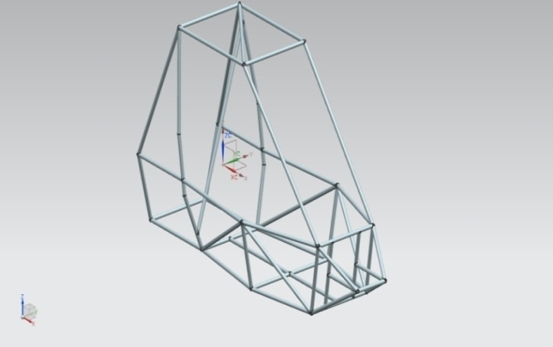
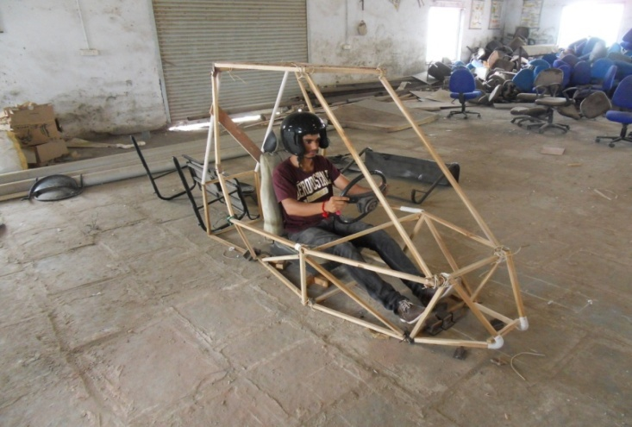
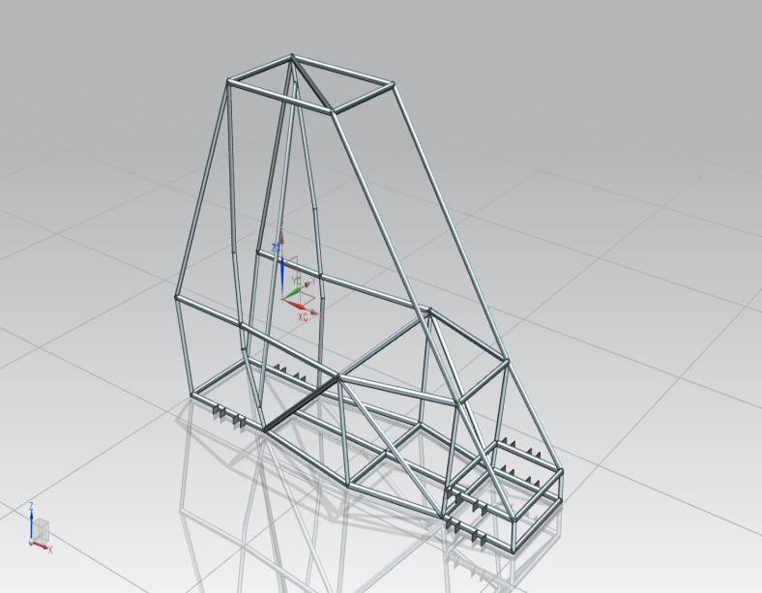
DESIGN METHODOLOGY
Preliminary Design
Mock-Up
Modified Design
Analysis (ANSYS)
Final Model
Design check using FEA Analysis
ROLL CAGE DESIGN:-
The design process of the vehicle is iterative and is based
on various engineering and reverse engineering processes depending upon the availability, cost and other such factors.
Safety , Serviceability .
Cost , Strength and Ruggedness.
Driving feel, Ergonomics , Aesthetics.
Strictly according to rule book 2013.
Accommodate team’s tallest driver.
Modification in design:-
Changes in nose portion.
Improving the weight distribution by shortening the length and try to maintain CG more close to the centre.
Material used:- AISI 4130
Carbon 0.28-0.33 %
Manganese - 0.40-0.60 %
Phosphors - 0.035%
Silicon - 0.04 %
Tensile Strength(Mpa) =560.5
Yield Strength(Mpa) = 360.6

Slide 4
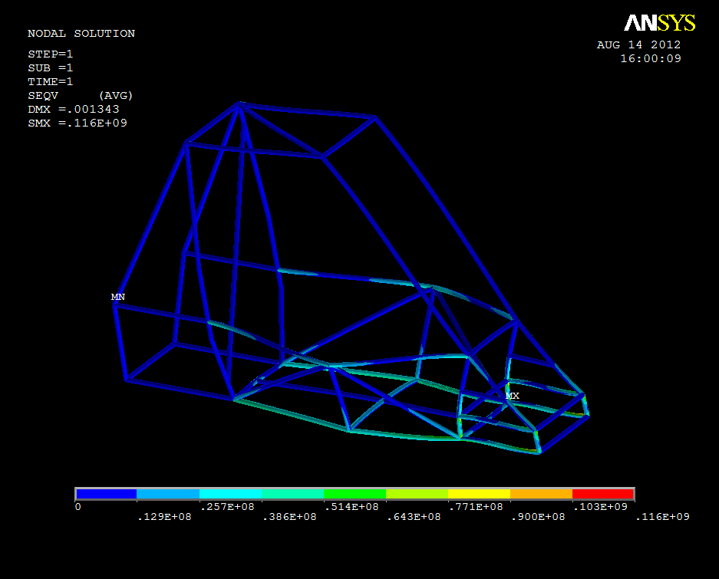
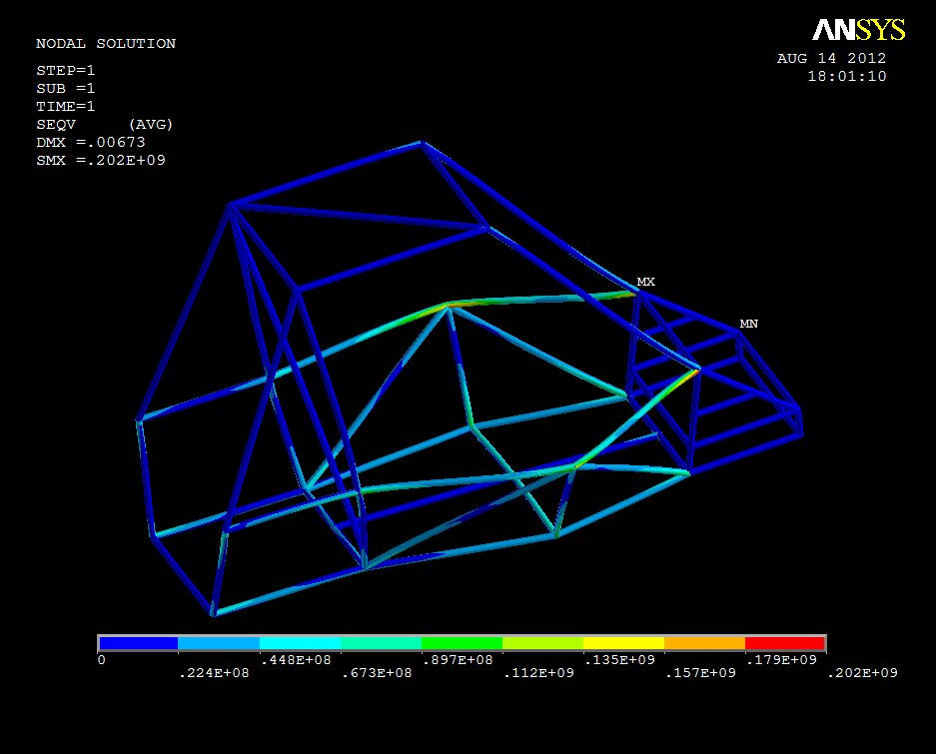
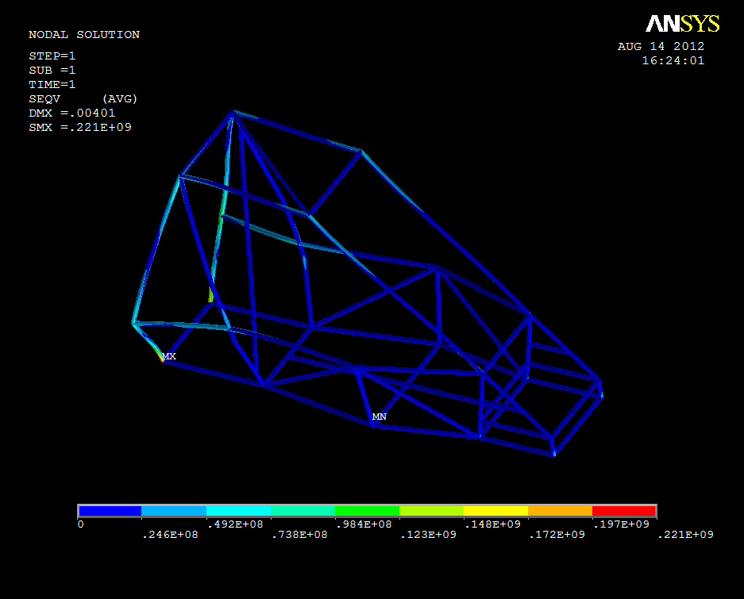
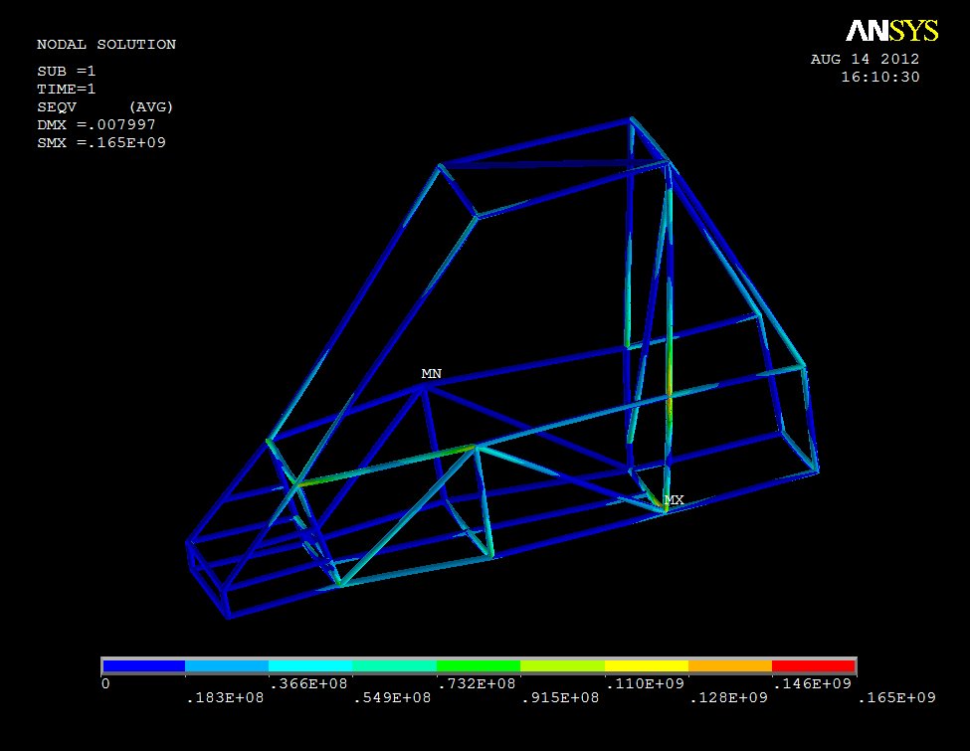
FINITE ELEMENT ANALYSIS
Front Impact
Rear Impact
Front Impact
Roll Over
Side Impact

Slide 5
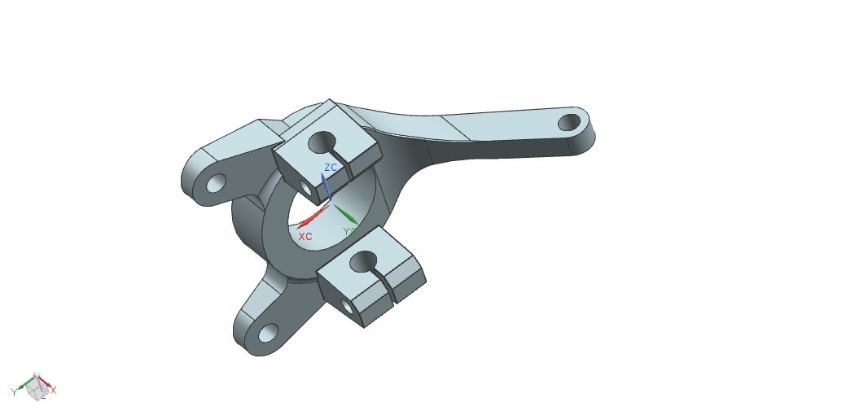
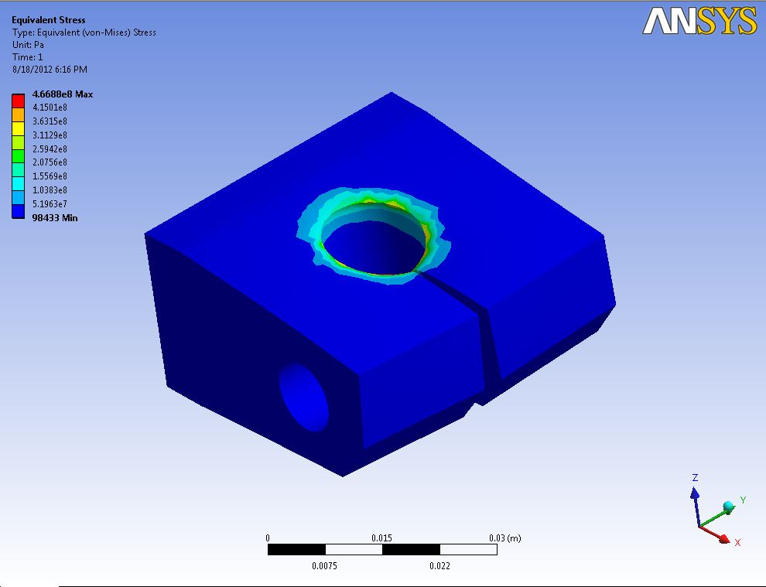
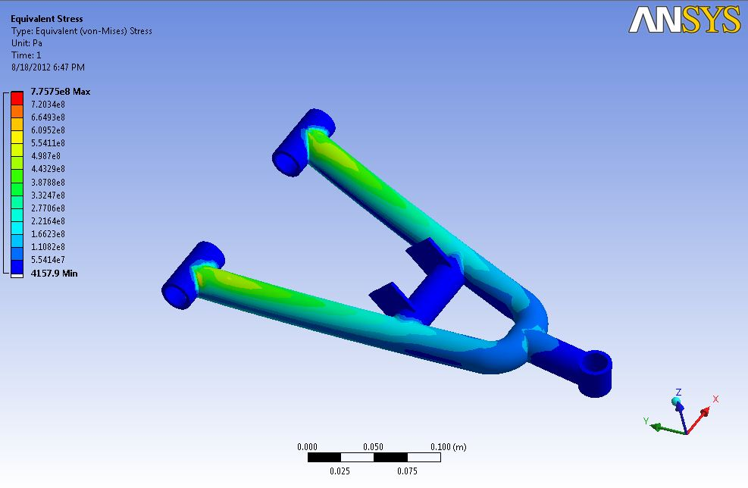
Knuckle Design
Knuckle Part Analysis
Calculation for Front and Rear impact :-
Mass of the vehicle (m) :- 400kg( inc. driver)
G force :- 5g = (9.81*5) = 49.50
Analytical Force Applied :- m * G force = 19800 N
Force Applied on :-
Side Impact:- 2g , Roll over Impact: - 2g
Knuckle :- 5000 N , Double Wishbone :- 5000 N
Factor of Safety:- Maximum Stress/ Permissible Stress =1.62
Conclusion :-
The analysis shows that maximum stresses are generated on SIM but are in permissible limit.
It is also to be understood that these forces are applied on the key points which is not the case in real scenario, In real these stresses are acted upon the whole member rather than only the key points.
Double Wishbone Analysis

Slide 6
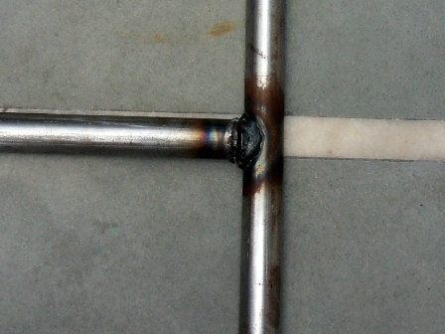
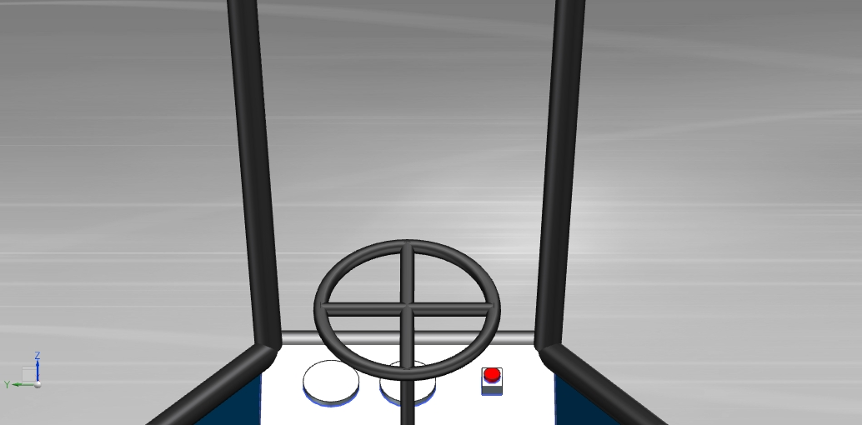
ERGONOMICS
UTM TESTING
Purpose:-
To check the weld strength.
Process:-
Two pipes of AISI 4130 welded at perpendicular to each other at mid point.
Conclusion:-
Ultimate load= 77.75 KN
Ultimate Tensile Strength = 348.65 N/mm²
Load was applied at weld joints at which welding fails and it is in the permissible limit. It is also confirms that maximum stress generated in analysis is also in the permissible limit.
Type of welding:- MIG Welding
Flexible driving posture for longer driving periods.
Wide front region for maximum vision of the road.
Sufficient room to reach pedals to allow good pedal control , making angle of knee joints of 120 °
Accessories and display panel in vicinity of the driver.
Use of Macpherson strut in rear to provide sufficient room in engine compartment for easy maintenance.
Adjustable Steering.
Fuel tanks away from the driver.
Adequate seating which absorbs shocks.

Slide 7
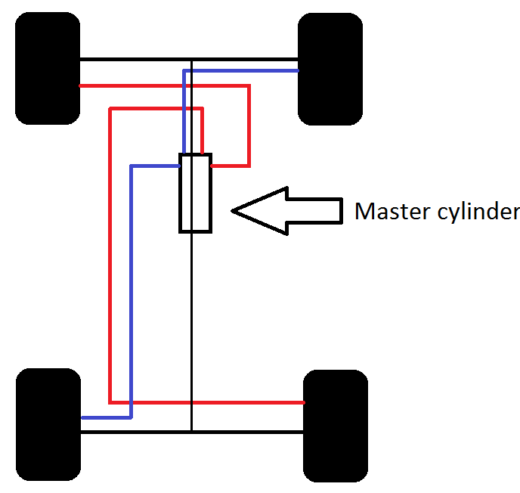
BRAKING SYSTEM
Gradeability
Braking System
1 | Brake used (Front & Rear) | Maruti 800 disc brakes
2 | Brake circuit | Two Independent Circuit
3 | Disc diameter | 215mm
4 | Brake force | 2746 N
5 | Master cylinder | Maruti 800
6 | Braking efficiency | 70%
Grade
Angle
Calculations :-
V = U + aT
V ² - U ² =2ad
D = V0+1/2 aT ²
Stopping distance of car at 45 km/h =11.38 m
Deceleration of car= -6.86 m/s ²
Time to stop = 1.825 s
Km/h
Brake Circuit

Slide 8
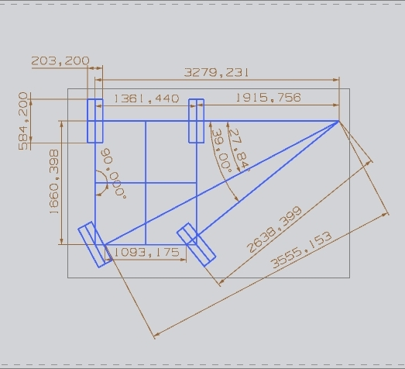
STEERING SYSTEM
Ackermann steering mechanism
Formula:-
Cot Ѳ_{o} – cotѲ _{i} = c/b
Where,
c= wheel track,
b= wheel base,
Ѳ_{o} = angle of outside lock,
Ѳ _{I} = angle of inside lock
Specification
Steering mechanism | Rack and pinion
Castor | 2°
Camber | 1°
Toe-in | 2 mm
Tie rod length | 9”
Turning radius inner front wheel | 2.63 m
Turning Radius outer front wheel | 3.55m
Turning Radius Rear Wheel | 1.91m
Turning Radius outer rear wheel | 3.27m
Inside lock angle | 39°
Outside lock angle | 28°

Slide 9
SUSPENSION
TRANSMISSION
Formula:-
H_{d}=½*g*t²
V_{i}= g*t
K.E= ½*m*v²
F_{i} = K.E/S
Where,
V_{i} is the Impact Velocity, F_{i} is the Impact Force
KE is the Kinetic Energy which must be absorbed
m is the mass of the vehicle
S is the displacement of the shock (travel)
GEAR BOX :-
M&M ALFA CHAMPION , 4 Speed Constant Mesh, 4F and 1R.
ENGINE:-
Briggs & Stratton OHV Intake Model.
Maximum RPM :- 3800rpm
Wheels :- Polaris 23*8*12
Speed formula :- 2*∏*R*N*60
1000*GR
GR= gear ratio
1st gear ratio :- 31.48:1
2nd gear ratio :- 18.70:1
3rd gear ratio :- 11.40:1
4th gear ratio :- 7.35:1
Reverse gear :- 55.08:1
Top Speed :- 57.30 km/h
Acceleration :- Final Speed – Initial Speed =15.91/7 = 2.27 m/s ²
Time
Height of drop H_{d} (ft) | Time t (s) | Impact velocity V_{i} _{(m/s)} | Kinetic energy K.E (N*m) | Impact force F_{i} (N)
4 | 0.4988 | 4.8932 | 46679.72 | 4965.92
3 | 0.4319 | 4.2369 | 31250 | 3324.46
2 | 0.3527 | 3.4599 | 18903.88 | 2011.05
1 | 0.2494 | 2.4466 | 9644.44 | 1026.00
Used | Type | Wire Dia. | Coil Dia. | No. of active turns | Spring index | Suspension Travel
Front Mono cross | Double A-arm | 0.39 | 3.77 | 9 | 9.613 | 4.7”
Rear Maruti 800 | Mac-pherson Strut | 0.38 | 3.54 | 8 | 9.292 | 4”
Kmh / | 1000 RPM | 2000 RPM | 3000 RPM | 3800 RPM
1st gear | 3.5 | 7 | 10.6 | 13.4
2nd gear | 5.9 | 11.4 | 17.8 | 22.5
3rd gear | 9.7 | 19.40 | 29.1 | 36.9
4th gear | 15.1 | 30.1 | 45.2 | 57.3
Reverse gear | 1.99 | 3.99 | 5.99 | 7.59

Slide 10
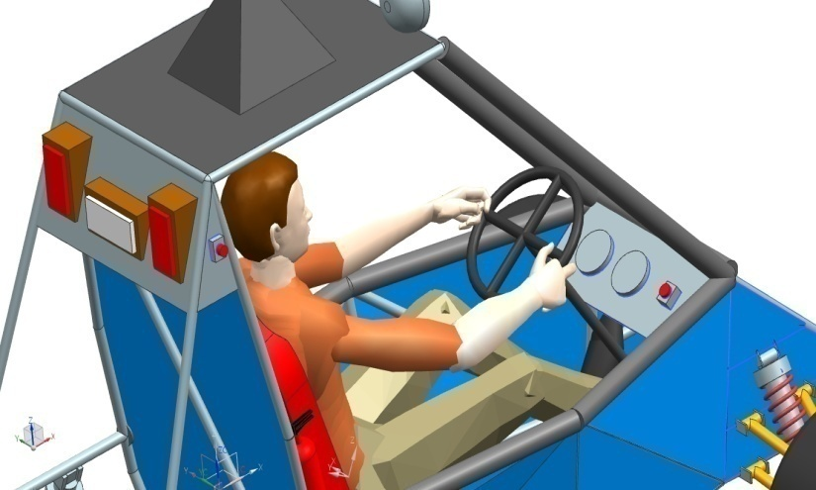
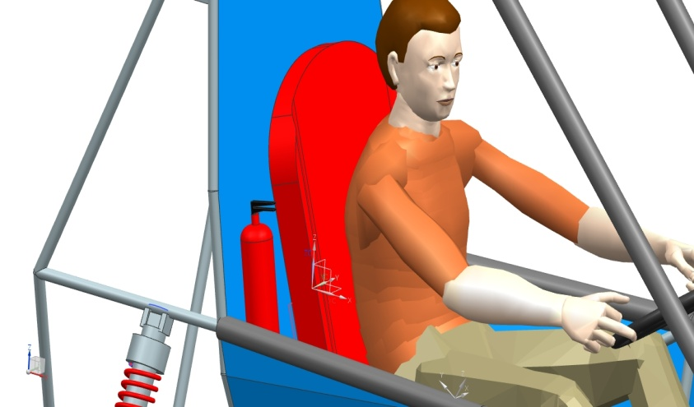
SAFETY
BELLY PAN & LEG AND FOOT SHIELDING:- These shielding are provided to prevent debris & foreign object intrusion in driver compartment.
FIRE EXTINGUISHER:- 1kg Fire extinguisher is mounted in the cockpit below the driver’s head, with the top half above the side impact member on the right side of the firewall and it is easily accessible by course workers
BRAKE LIGHT:- The brake light is mounted at a 40” above the ground , Light is mounted in such a way that it shines parallel to the ground, not up at an angle.
DRIVER RESTRAINT:- 5 point restraint harness is used.
KILL SWITCH :- Vehicle is equipped with two easily accessible kill switches to push off the ignition.
BUCKET SEAT :- Seat is Mounted not intruding the plane of RRH and comfortable for the driving purpose.

Slide 11
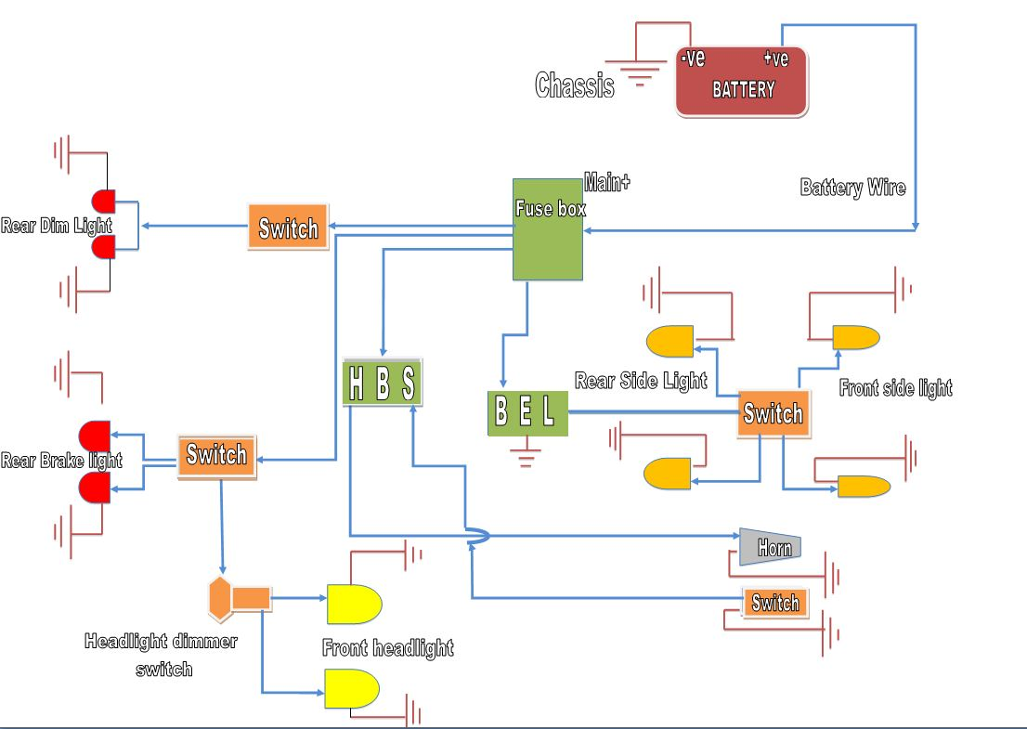
ELECTRICAL CIRCUIT

Slide 12
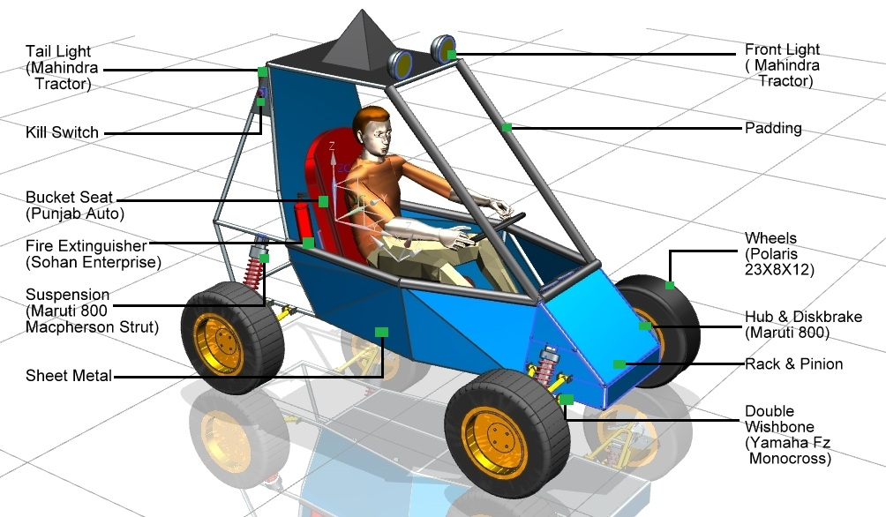
CAD MODEL & COST ESTIMATION
Component | Estimated Cost
Engine | 22,000
Transmission & Drive train | 65,000
Roll cage & Mounting | 18,000
Braking System | 18,500
Suspension | 21,500
Steering System | 11,500
Electrical System | 11,250
Safety Kit & bucket seat | 28,000
Miscellaneous | 23,100
Total | 2,18,350

Slide 13
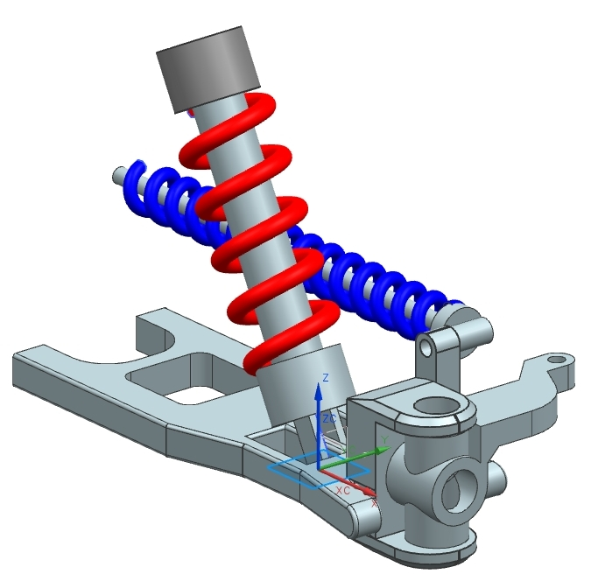
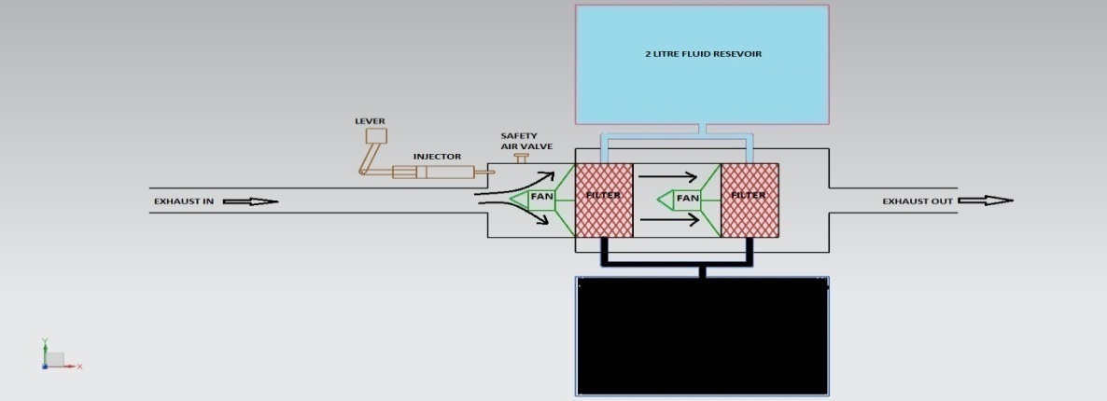
DESIGN VALIDATION PLAN
GO GREEN & INNOVATION
POLLUTION CONTROLLER DEVICE
SUSPENSION DESIGN
Sr No. | Test | Requirement for Test | Criteria
1. | Weight | Weighbridge | 400kg ( +/- 5% )
2. | Speed | Off Road | Not exceeding 60 km/h
3. | Turning Radius | Open Track | 3.55 meter (+/- 0.25)
4. | Fuel | Fuel meter | Time for Refueling (check)
5. | Gradeability | Inclined Track | Smooth ride for pre determined calculations
6. | Water Test | Special Track | Easy ride
7. | Pollution test | PUC meter | Go green
8. | Functional test | 1 hours riding on Off Road | Checking all parts

Slide 14
DFMEA
Components | Potential failure mode | Potential effects of failure | Severity | Potential causes | Occurrence | Current process control | Risk priority number
BRAKES | BRAKE OIL, HOT SPOTS | VEHICLE OUT OF CONTROL | 6 | OIL LEAKAGE OR BREAKLINE BLOCKAGE, EXCESSIVE COMMON BRAKING POINT | 4 | REGULAR CHECKING OF OIL, DISK SETTING TO AVOID CONTACT WITH DAMAGED AREA | 24
SUSPENSION | WORN STRUTS OR BALL JOINTS | WHEELS OUT OF BALANCE,TYRES WORN UNEVENLY | 5 | SUDDEN IMPACT OUT OF RANGE | 3 | REPLACE CONCERNED PART AT CERTAIN INTERVAL | 15
ROLL CAGE | DIRECT NOSE COLLISION | DRIVER’S SAFETY RISK,STEERING COLUMN BREAKAGE | 4 | WEAK WELDINGS JOINTS, | 3 | USING IMPACT ENERGY DIFFUSER(IED) | 12
TYRES AND A ARM | FRONT IMPACT ON TYRES | BREAKING OF A ARM ROLL CAGE JOINT | 7 | NO SHOCK ABSORBER AND SAFTEY GUARD. | 5 | USING IMPACT ENERGY DIFFUSER(IED) | 35
KILL SWITCH | CONTACT WITH CONDUCTING MATERIAL LIKE MUD | ENGINE STOPS | 6 | IMPROPER POSITIONING | 3 | MOUNT IT AWAY FROM DISTURBANCE PRONE AREA | 18

Slide 15
TEAM ORGANIZATION STRUCTURE
LOGISTIC DEPARTMENT
FACULTY ADVISOR
TEAM CAPTAIN
DESIGNING DEPARTMENT
FABRICATION DEPARTMENT
ELECTRICAL DEPARTMENT
PROJECT PLAN
Critical
Non- Critical

